Slide 1




THE APPLICATION OF VARIED MACHINE LEARNING ALGORITHMS FOR OBESITY CLASSIFICATION
CS 513 KDDM SECTION B
GROUP 08
Sri Laya Nalmelwar(20018028)
Sindhu Buggana (20020990)
Vaishnavi Nadipalli(20022226)
Naga Durga Jai Rathan Ghanta(20020455)

Slide 2
ABSTRACT
This research introduces a sophisticated machine learning framework designed specifically for obesity classification, addressing a critical global health issue.
The importance of early detection and intervention is paramount to reduce the adverse impacts of obesity on individual health and healthcare systems. The framework utilizes a detailed approach, incorporating multiple machine learning techniques to improve accuracy and reliability in obesity prediction.
Aims to facilitate early obesity detection and craft personalized intervention strategies, contributing to broader public health initiatives focused on obesity prevention and management.
By harnessing a diverse set of machine learning algorithms and ensemble methods, this research contributes significantly to developing an effective obesity classification system, supporting global efforts to mitigate obesity-related health risks and promote healthier lifestyles.

Slide 3
OBESITY
• Obesity Origins and Causes:
- Complex, multifactorial condition with genetic and environmental factors or Environmental factors like unhealthy lifestyle
• Types and Classification of Obesity: (BMI calculated from ht and wt)
- Overweight (BMI 25-29.9), Class I Obesity (BMI 30-34.9), Class II (BMI 35-39.9), Class III/Morbid Obesity (BMI ≥40)
- Also classified by body fat distribution - android/male-type vs gynoid/female-type
• Prevalence and Trends:
- Globally, obesity has nearly tripled since 1975 (WHO)
- Over 1.9 billion adults overweight in 2016, 650 million obese where childhood/adolescent obesity has increased alarmingly
• Health Consequences and Comorbidities:
- Increased risk of chronic conditions like heart disease, stroke, type 2 diabetes, certain cancers, Obstructive sleep apnea, osteoarthritis, reproductive issues, Higher mortality rates from all causes

Slide 4
RESEARCH PROBLEM
Recent years have seen a significant increase in the use of conventional machine learning algorithms by numerous researchers aimed at enhancing the predictive accuracy for obesity classification and Rising prevalence rates, significant health consequences and economic burden.
Yet still, ensemble machine algorithms has also been enacted.
Pushed the boundaries by deliberately removing the height and weight feature columns from the dataset, aiming to achieve similar accuracy levels without these crucial features, thereby testing the robustness and adaptability of the models, highlighting the importance of feature engineering and selection, and demonstrating a commitment to developing a versatile solution capable of delivering reliable results even with missing or unavailable data.
The machine learning algorithm chosen contribute significantly to heighten predictive accuracy for obesity classification. Hence, conventional machine learning or ensemble machine learning algorithms must be chosen with reasonability.
This conundrum has led to this question: Might the accuracy of obesity prediction been enhanced if an Ensemble Machine Learning (EML) algorithms is chosen to classify between “0” no obesity and "1" non-obesity or obesity?
This research thus answers the question through the implementation of a eight-machine learning algorithms; six conventional machine learning algorithms and two ensemble machine learning algorithm for predicting obesity by also keeping all the important factors that lead to obesity as the features.
These algorithms provides a comparative analysis, determining appropriateness and superiority.

Slide 5
AIM AND OBJECTIVES OF THE PROJECT
AIM:
The overarching aim of this project is to develop an accurate and reliable machine learning-based system for classifying obesity, enabling early detection, personalized intervention strategies, and supporting public health initiatives focused on obesity prevention and management.
OBJECTIVES:
Develop accurate machine learning models for obesity classification by implementing and evaluating diverse algorithms, including conventional and ensemble methods.
Ensure model interpretability, assess feature importance, and validate performance using appropriate techniques and metrics.
Explore deployment strategies, scalability considerations, and address ethical concerns related to personal health data privacy.

Slide 6
SCOPE OF THE PROJECT
• Data Scope: Comprehensive obesity dataset with relevant features. Data cleaning and preprocessing techniques
• Algorithmic Scope: Implementation of conventional machine learning algorithms and Ensemble methods for enhanced performance
• Validation and Performance Evaluation: Validation techniques (cross-validation, holdout sets), Performance metrics (accuracy, precision, recall, F1-score), Hyperparameter tuning strategies
• Interpretability and Feature Importance: Model interpretation and decision explanations and analysis of feature contributions
• Deployment and Integration: Strategies for deploying trained models by Integration with healthcare systems or applications so it can addresses the global health concern of obesity and its associated risks (e.g., cardiovascular diseases, type 2 diabetes, certain cancers)
• Scalability and Generalization: Scalability to larger datasets with generalization across populations and demographic groups, Enables early detection and intervention for obesity through an effective classification system
• Ethical and Privacy Considerations: Ethical use of personal health data and also with compliance with data privacy regulations

Slide 7
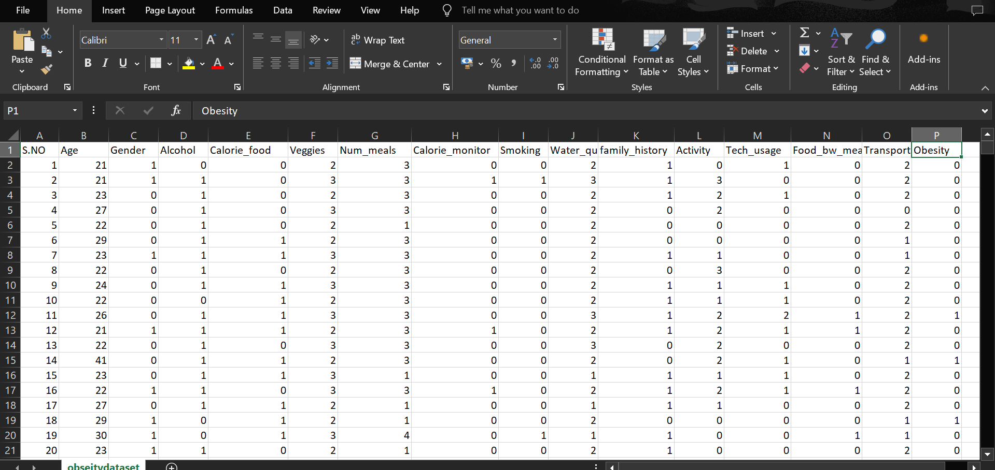
DESCRIPTION OF THE DATASET
Figure 1(a): Sample of obesity dataset from Kaggle [1-20 samples]

Slide 8
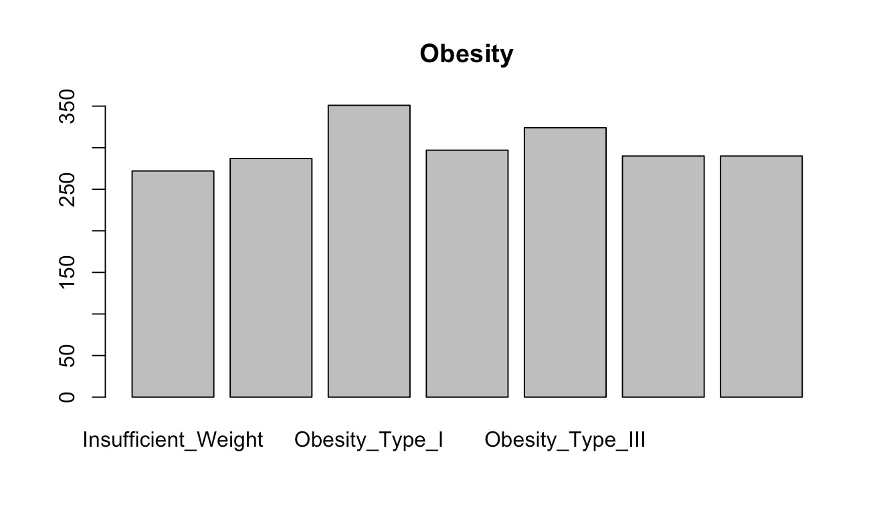
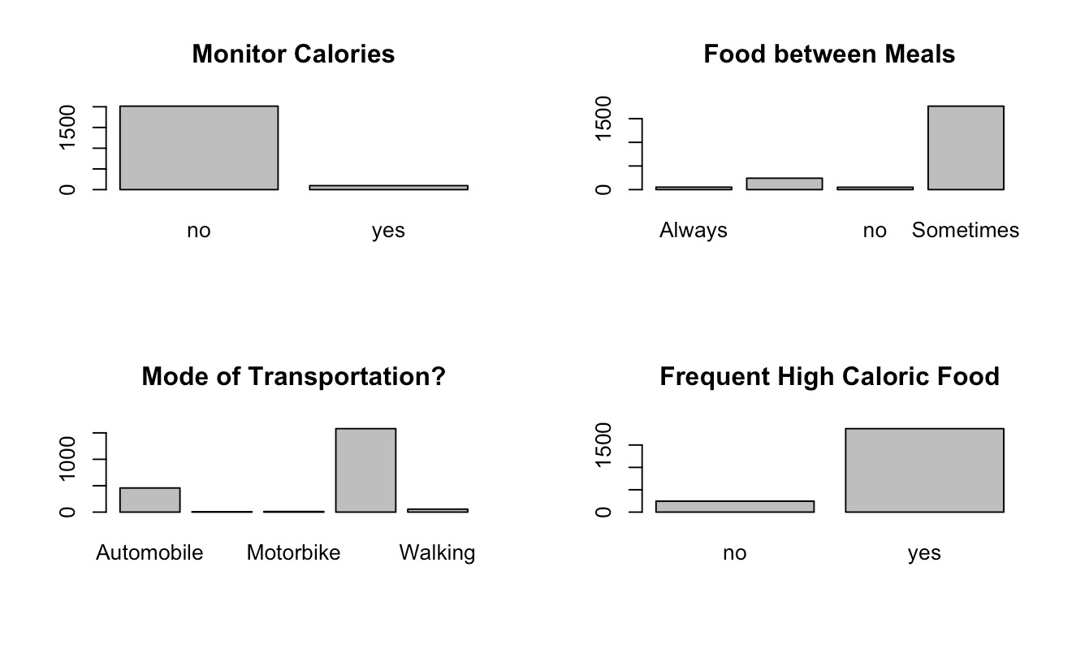
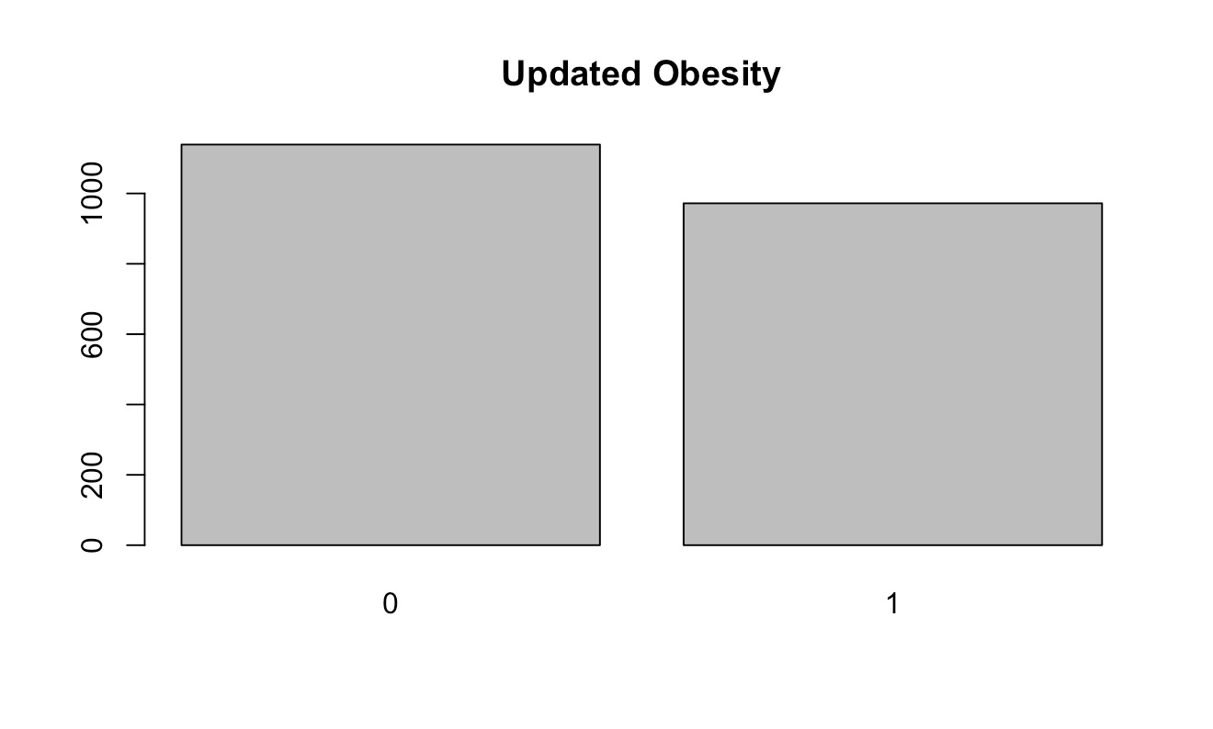
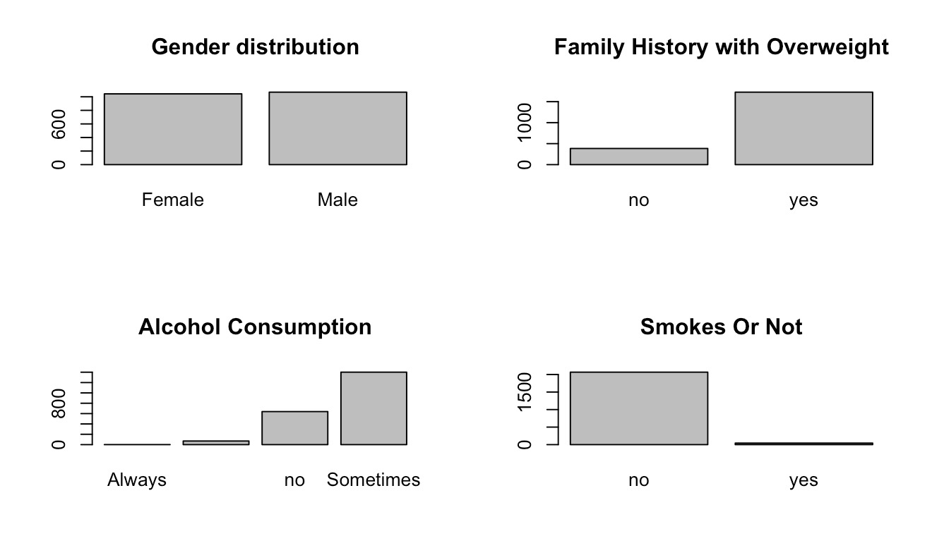
EXPLORATORY DATA ANALYSIS
Initial Target feature : consisting of different of weight types
Target Variable Distribution: Obesity column after the EDA converting it into target variable consisting of 2 types(0- non-obese, 1- obese)
Feature Distribution: Initial Dataset Features

Slide 9
PROJECT METHODOLOGY
Machine Learning algorithms: The project selected 8 machine learning algorithms. Of these eight, six are selected as conventional machine learning algorithms while two where selected as ensemble machine algorithms.
Machine Learning dataset: The dataset applied for the classification of Obesity was obtained from https://www.kaggle.com/datasets/fatemehmehrparvar/obesity-levels/data. The dataset contains 2111 samples and 19 columns.
- Last Column (Obesity) is the TARGET VALUE with “0” for no Obesity and “1” for Obesity.
Data Cleaning: From the initial 19 features, 15 were selected by excluding height, weight, and other unnecessary data columns. The last column, which consisted of various obesity types and weight categories such as Obesity_Type_I, Obesity_Type_III, Obesity_Type_II, Overweight_Level_I, Overweight_Level_II, Normal_Weight, and Insufficient_Weight, was modified to represent a binary classification: obese or non-obese.
Exploratory data Analysis (EDA): The missing values were identified with question mark (?) and then replaced with the column mean values. The dataset were partitioned 70:30.
Implementation of the 8 machine learning algorithms utilizing 70% of EDA dataset.
Validation of the 8 machine learning algorithms utilizing 30% of EDA dataset.
Comparative analysis for the 8 machine learning algorithm utilizing six statistical metrices.

Slide 10
PROJECT METHODOLOGY CONTD.
The six statistical metrices were subsequently compared for each machine learning algorithms and appropriate findings were identified. The six statistical metrices selected included:
Accuracy is given as: TP +TN/ (TP+FP+TN+FN)
Sensitivity is given as: TP/ (TP +FN)
Specificity is given as: TN/ (TN +FP)
Precision is given as: TP / (TP + FP)
Recall is given as: TP / (TP + FN)
F1 Score is given as: 2 x [(Precision x Recall) / (Precision + Recall)].

Slide 11
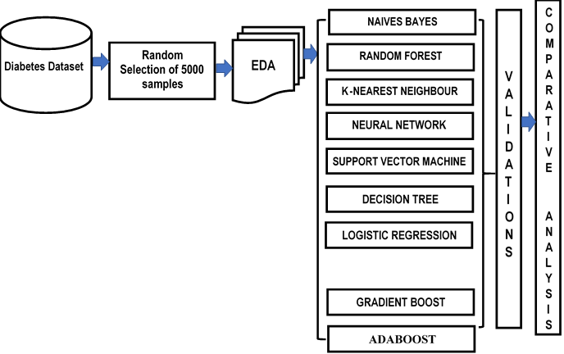
OBJECTIVE A- MACHINE LEARNING ARCHITECTURE FOR OBESITY CLASSIFICATION
Conventional machine algorithms
Figure : Machine Learning Architecture
Obesity
Dataset
Selection of Samples
LOGISTIC REGRESSION
Ensemble machine algorithms

Slide 12
MACHINE LEARNING ARCHITECTURE
The machine learning architecture captured on above figure present five components.
Obesity Dataset: Having a dataset samples of 2111, we narrowed it down to 15 features and performed data cleaning.
Exploratory Data Analysis (EDA): The dataset was scan from missing values and replaced with column mean. The EDA was subsequently categorized as 70% and 30%, training and testing respectively.
Machine Learning Algorithms Implementation: Seventy (70%) of the dataset coming from EDA phase was feed into the eight machine learning algorithms.
Validation (testing): Thirty (30%) of the dataset coming from EDA was utilized for validation or testing.
Comparative Analysis: This phase provide comparative analysis along statistical metrices to ascertain appropriateness as aligned with the obesity dataset.

Slide 13
OBJECTIVE B
Implementation of the Machine Learning Algorithms For obesity Classification

Slide 14
ALGORITHMS USED
Employs various machine learning algorithms for prediction.
Includes Naive Bayes for probabilistic insights.
Uses Random Forest for ensemble decision-making.
Applies K-Nearest Neighbor for instance-based learning.
Implements Support Vector Machine for high-dimensional data classification.
Utilizes Decision Tree for straightforward decision modeling.
Deploys Logistic Regression for binary classification tasks.
Compares Gradient Boost and AdaBoost to optimize prediction accuracy.

Slide 15
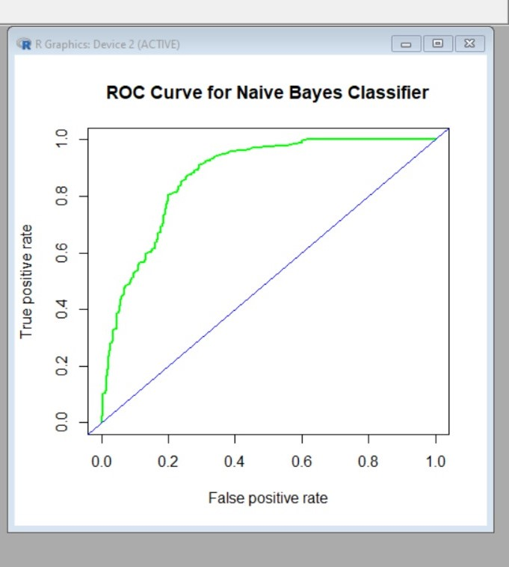
NAIVES BAYES
Statistical Measures
Accuracy: 90.74%
Sensitivity: 89.09%
Specificity: 92.78%
Precision: 93.83%
Recall: 89.09%
F1 Score: 91.40%
Navies Bayes:
Reference
Prediction 0 1
0 299 24
1 68 277
Figure : Naïve Bayes

Slide 16
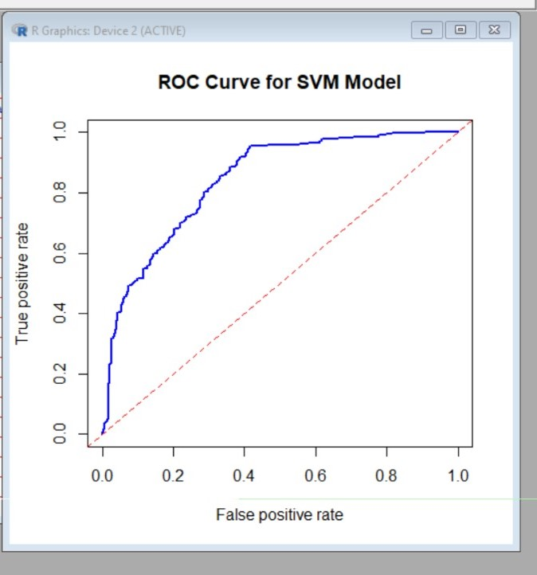
SUPPORT VECTOR MACHINE
Statistical Measures
Accuracy: 77.38%
Sensitivity: 67.59%
Specificity: 94.04%
Precision: 95.08%
Recall: 67.59%
F1 Score: 79.01%
SVM:
Reference
predictions 0 1
0 219 14
1 148 287
Figure : SUPPORT VECTOR MACHINE

Slide 17
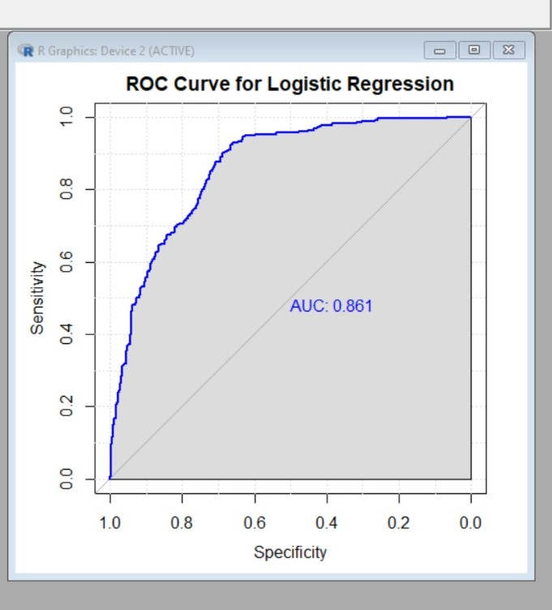
LOGISTIC REGRESSION
Statistical Measures
Accuracy: 76.94%
Sensitivity: 10.76%
Specificity: 97.49%
Precision: 87.37%
Recall: 68.08%
F1 Score: 76.53%
Logistic Regression:
Reference
Prediction 0 1
0 243 33
1 124 268
Figure : Logistic Regression

Slide 18
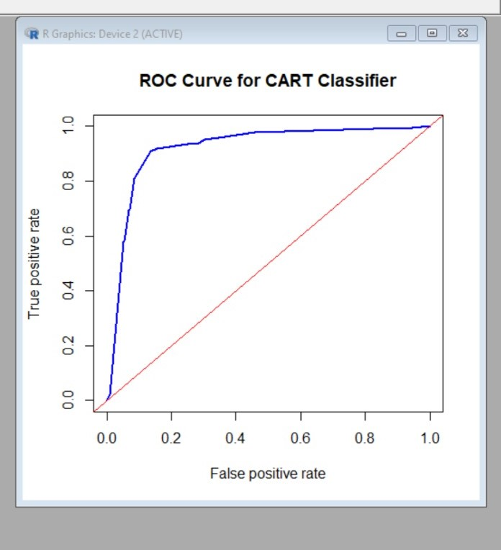
DECISION TREE
Statistical Measures
Accuracy: 82.37%
Sensitivity: 78.11%
Specificity: 86.36%
Precision: 84.26%
Recall: 78.11%
F1 Score: 81.07%
CART:
Reference
predictions 0 1
0 302 44
1 65 257
Figure : Decision Tree

Slide 19
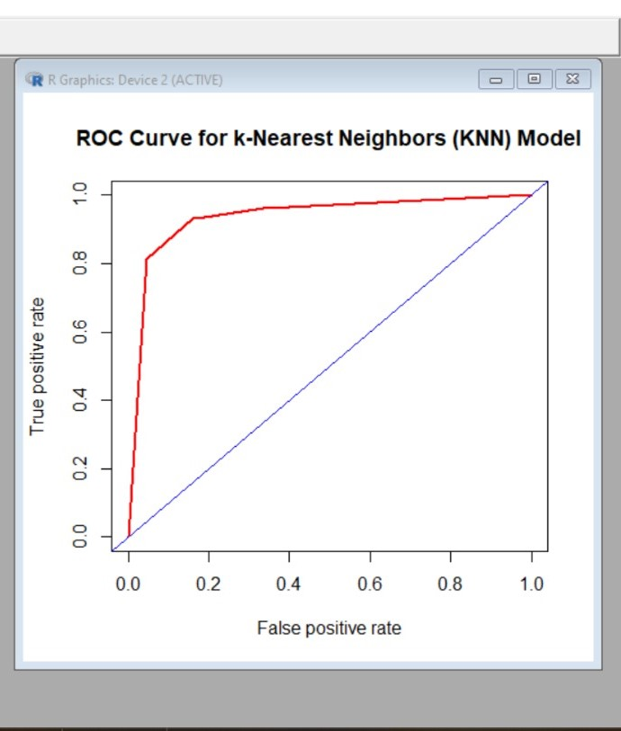
K- NEAREST NEIGBOUR
Figure : K-Nearest Neighbor
Statistical Measures
Accuracy: 87.37%
Sensitivity: 81.38%
Specificity: 94.75%
Precision: 95.03%
Recall: 81.38%
F1 Score: 87.67%
Confusion Matrix KNN:
Reference
Prediction 0 1
0 299 24
1 68 277

Slide 20
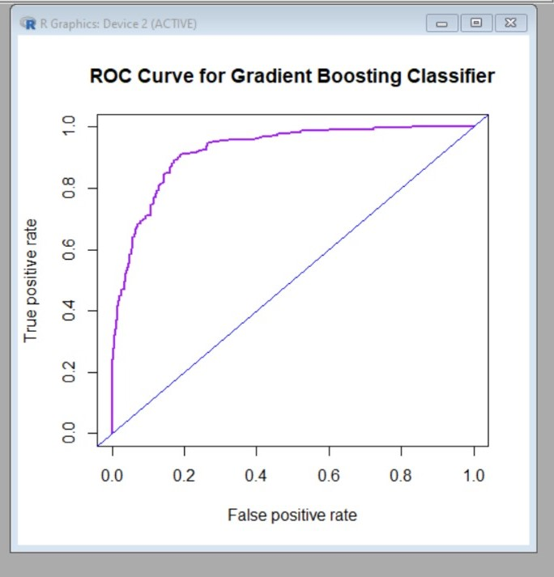
GRADIENT BOOST
Statistical Measures
Accuracy: 90.74%
Sensitivity: 89.09%
Specificity: 92.78%
Precision: 93.83%
Recall: 89.09%
F1 Score: 91.40%
Gradient Boost:
Reference
Prediction 0 1
0 294 53
1 73 248
Figure : Gradient boost

Slide 21
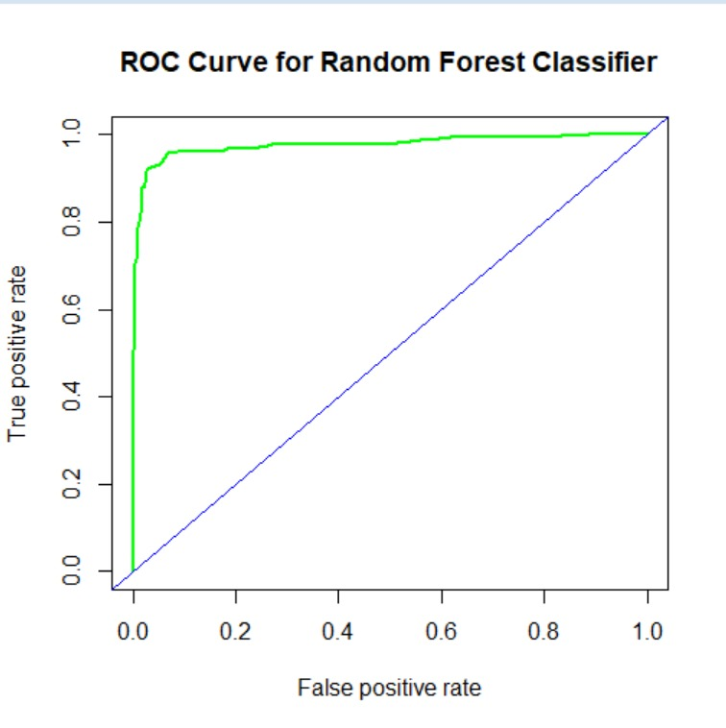
RANDOM FOREST
Statistical Measures
Accuracy: 92.51%
Sensitivity: 90.95%
Specificity: 94.42%
Precision: 95.26%
Recall: 90.95%
F1 Score: 93.06%
Random Forest:
Reference
Prediction 0 1
0 339 22
1 28 279
Figure : Random Forest

Slide 22
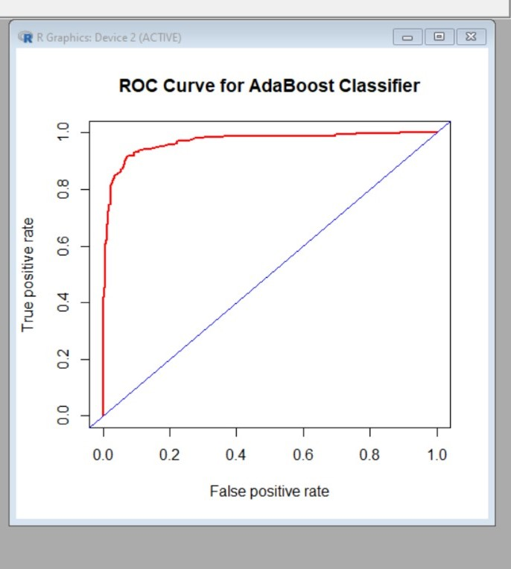
ADABOOST
Statistical Measures
Accuracy: 90.74%
Sensitivity: 89.09%
Specificity: 92.78%
Precision: 93.83%
Recall: 89.09%
F1 Score: 91.40%
AdaBoost:
Reference
Prediction 0 1
0 328 29
1 39 272
Figure : Adaboost

Slide 23
OBJECTIVE C
VALIDATION OF MACHINE LEARNING ALGORITHMS FOR OBESITY CLASSIFICATION.

Slide 24
VALIDATION OF MACHINE LEARNING ALGORITHMS FOR obesity CLASSIFICATION.
S/N | MACHINE LEARNING ALGORITHM | ACCURACY TP +TN/ (TP+FP+TN+FN) | SENSITIVITY TP/ (TP +FN) | SPECIFICITY TN/ (TN +FP) | PRECISION TP / (TP + FP) | RECALL TP / (TP + FN) | F1 SCORE 2 x [(Precision x Recall) / (Precision + Recall)].
Conventional Machine Learning Algorithm
1. | Naives Bayes | 90.74% | 89.09% | 92.78% | 93.83% | 89.09% | 91.40%
2. | Random Forest | 92.51% | 90.95% | 94.42% | 95.26% | 90.95% | 93.06%
3. | K-Nearest Neighbor | 87.37% | 81.38% | 94.75% | 95.03% | 81.38% | 87.67%
4. | Support Vector Machine | 77.38% | 67.59% | 94.04% | 95.08% | 67.59% | 79.01%
5. | Logistic Regression | 76.94% | 68.08% | 87.86% | 87.37% | 68.08% | 76.53%
6. | Decision Tree | 82.37% | 78.11% | 86.36% | 84.26% | 78.11% | 81.07%
7. | Logistic Regression | 84.60% | 10.76 | 97.49 | 42.86% | 10.76% | 17.20
Ensemble Machine Learning Algorithm
7. | Gradient Boost | 90.74% | 89.09% | 92.78% | 93.83% | 89.09% | 91.40%
8. | AdaBoost | 90.74% | 89.09% | 92.78% | 93.83% | 89.09% | 91.40%

Slide 25
OBJECTIVE D
COMPARATIVE ANALYSIS OF MACHINE LEARNING ALGORITHMS FOR OBESITY CLASSIFICATION.

Slide 26
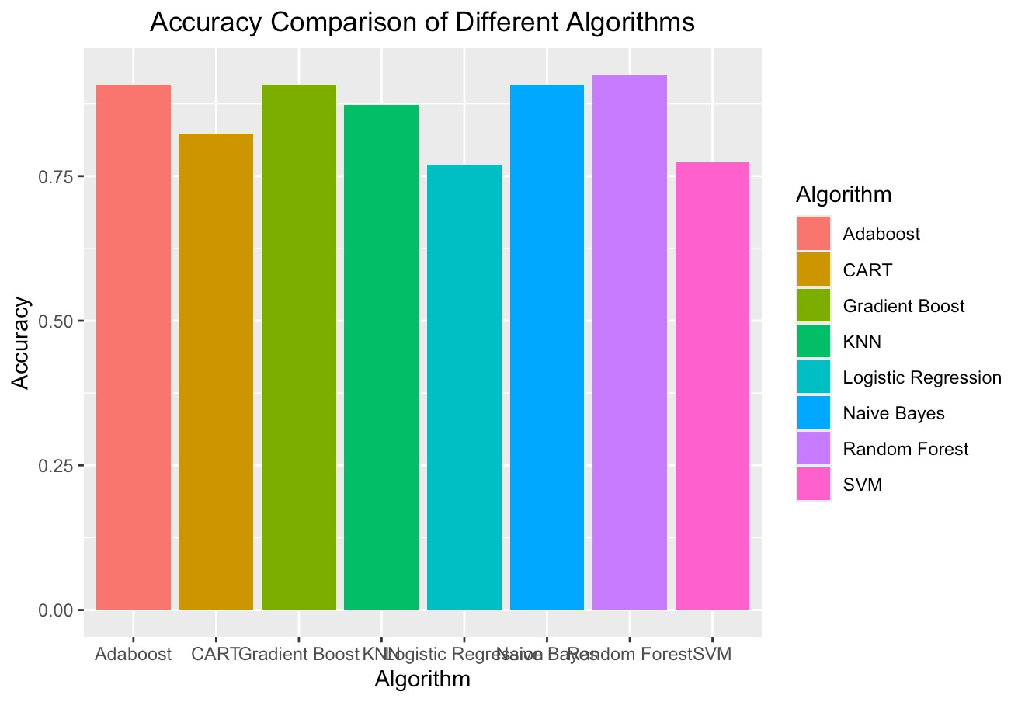
ACCURACY
Figure : Accuracies of the Implemented Machine learning Algorithm
Figure depicts the accuracies of the machine learning algorithms implemented. From the graph Random Forest, has the highest accuracy value with 92.51%. This followed by three algorithms Adaboost, Navie Bayes, Gradient Boost with an accuracy value of 90.74%.

Slide 27
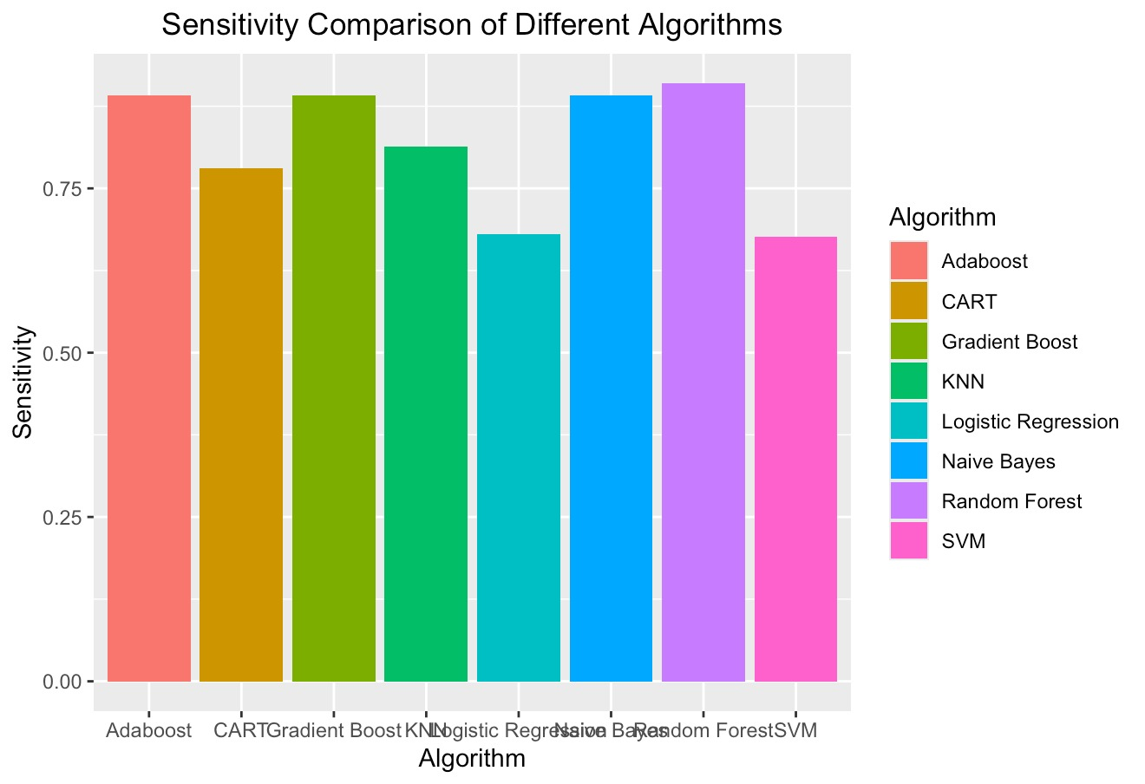
SENSITIVITY
Figure : Sensitivity of the Implemented Machine learning Algorithm
Figure depicts the sensitivity of the machine learning algorithms implemented. From the graph Random Forest, has the highest sensitivity value of 90.95%. This followed by three algorithms Adaboost, Navie Bayes, Gradient Boost with a sensitivity value of 89.09%.

Slide 28
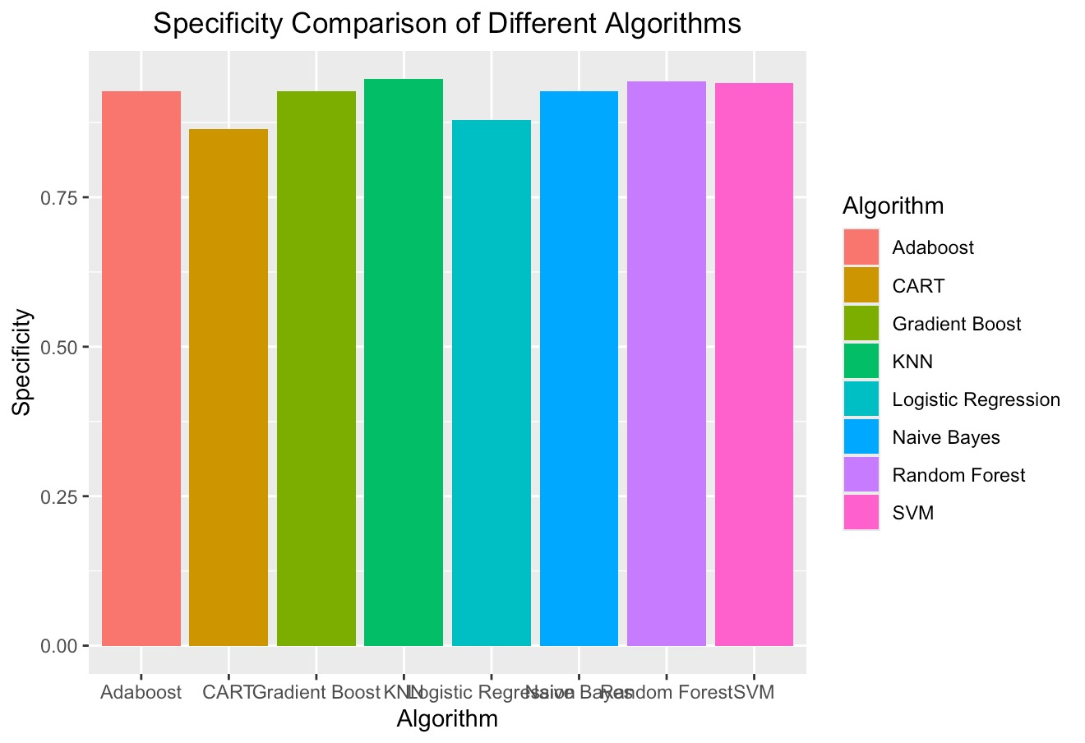
SPECIFICITY
Figure : SPECIFICTY of the Implemented Machine learning Algorithm
Figure depicts the specificity for the machine learning algorithms implemented. From the graph KNN, has the highest specificity value of 94.75%. This followed by Random Forest with a specificity value of 94.42%.

Slide 29
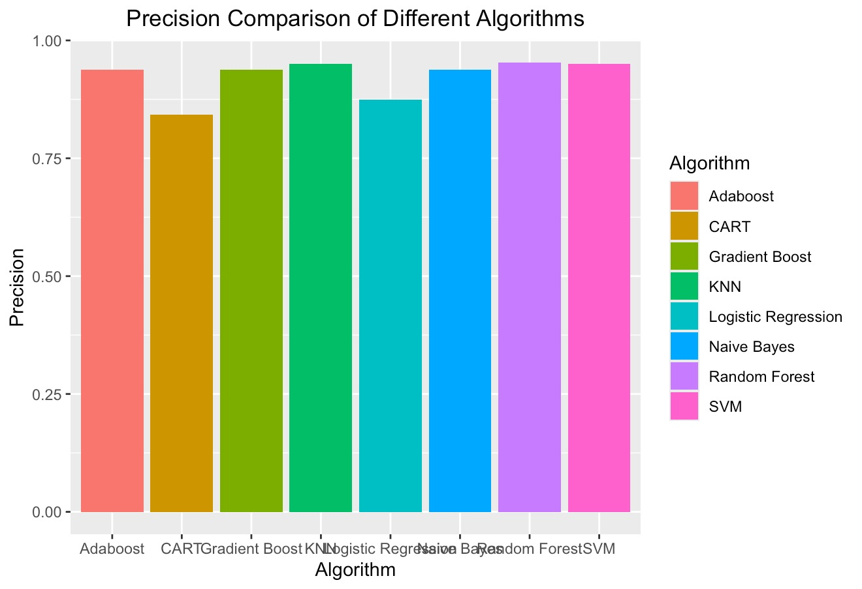
PRECISION
Figure : PRECISION of the Implemented Machine learning Algorithm
Figure depicts the precision for the machine learning algorithms implemented. From the graph Random Forest, has the highest precision value of 95.26%. This followed by SVM with a precision value of 95.08%.

Slide 30

RECALL
Figure : Recall of the Implemented Machine learning Algorithm
Figure depicts the recall of the machine learning algorithms implemented. From the graph Random Forest, has the highest recall with a 90.09%. This followed by three algorithms Adaboost, Navie Bayes, Gradient Boost with a recall value of 89.09%.

Slide 31
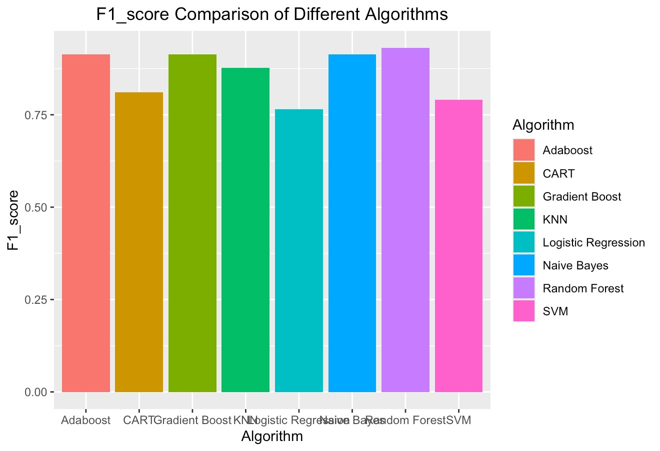
F1 SCORE
Figure : F1 SCORE of the Implemented Machine learning Algorithm
Figure depicts the F1 score of the machine learning algorithms implemented. From the graph Random Forest, has the highest F1 Score with a 93.06%. This followed by three algorithms Adaboost, Navie Bayes, Gradient Boost with a F1 Score of 91.40%.

Slide 32
PROJECT CONCLUSION
• The project successfully developed and evaluated several machine learning models for accurate obesity classification using a comprehensive dataset.
• Comparative analysis identified the top-performing algorithms (e.g. Random Forest, Gradient Boosting) capable of reliably distinguishing between obese and non-obese individuals.
• Techniques like feature importance analysis provided insights into the key risk factors and health indicators contributing to obesity and to be treated accordingly.
• Model interpretation methods allowed for explaining the rationale behind obesity classifications made by the models.
• Potential deployment paths were explored, including integration with healthcare systems or mobile apps for obesity screening.
• Ethical considerations like data privacy and regulations around personal health data usage were thoroughly addressed.
• The accurate obesity classification system shows promise for enabling early detection, personalized interventions, and supporting public health obesity prevention efforts.
• Further research could explore expanding to larger datasets, enhancing interpretability, and implementing the system in real-world clinical settings.

Slide 33
PROJECT FINDINGS
The following findings was found from the research:
• Of all the algorithms considered, Random Forest had the highest accuracy of 92.51%, indicating its effectiveness in correctly classifying both obese and non-obese cases.
• In terms of precision, Random Forest again performed best with a score of 95.26%, demonstrating its ability to minimize false positives when predicting obesity.
• For recall (sensitivity), Random Forest exhibited the highest value of 90.96%, indicating its proficiency in correctly identifying true positive obesity cases.
• The F1 score, which combines precision and recall, was also highest for Random Forest at 93.06%, suggesting a good balance between these two metrics.
• Regarding sensitivity (true positive rate), Random Forest and KNN shared the highest value of 81.38%, effectively detecting a large proportion of actual obesity cases.
• In terms of specificity (true negative rate), KNN scored 94.75%, demonstrating its capacity to accurately identify non-obese individuals.
The findings highlight Random Forest as the top-performing algorithm across multiple evaluation metrics, closely followed by ensemble methods like Adaboost and Gradient Boost. Conventional algorithms like KNN, Logistic Regression, and SVM generally performed better than CART but lagged behind the ensemble techniques in most metrics.

Slide 34


